Slide 1
Symphony in Colours- A Blending of Music and Art in the Primary Classroom. BCPTA Presentation Nanaimo, BC October 25, 2019

Slide 2
Presenters
Mary Payne
Tina Crookshank
Shelly Carson
Music playlists done by Roy Carson
School District #47-Powell River

Slide 3
Mission Statement
In the spirit of the new curriculum and
the blending of music, art and dance
as a wholistic approach to the arts,
we decided to share some projects
with you to demonstrate this blending.

Slide 4
Milly, Molly, Mildred (and Marvin)

Slide 5
A Definition of ‘Symphony’ in the context of this project.
Anything characterized by
a harmonious combination
of elements, esp. an effective
combination of colors.

Slide 6
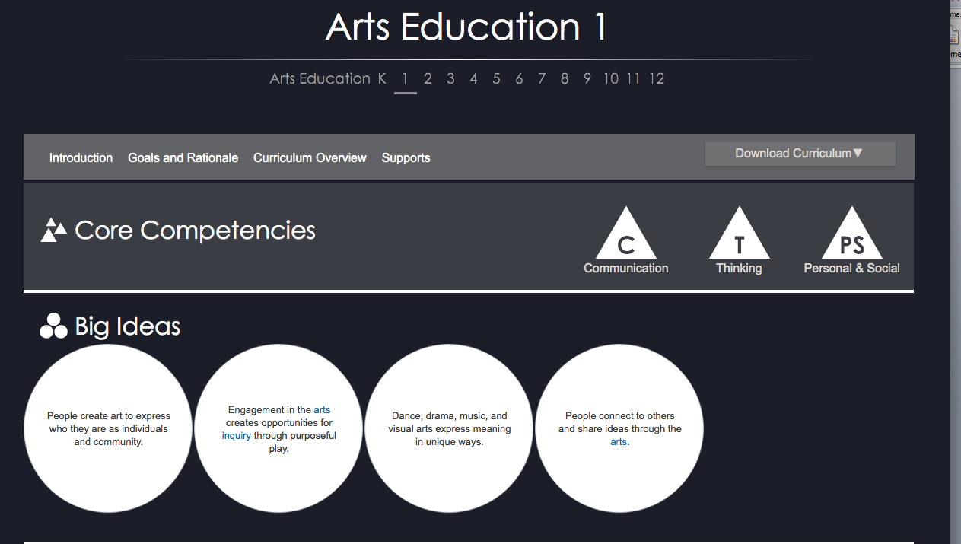

Slide 7
Curricular Competencies
-Explore elements, processes, materials,
movements, technologies, tools, and
techniques of the arts
-Develop processes and technical skills
in a variety of art forms to nurture
motivation, development, and imagination
-Express feelings, ideas, stories, observations,
and experiences through the arts

Slide 8
Curricular Competencies
-Create artistic works collaboratively and
as an individual, using ideas inspired by
imagination, inquiry, experimentation,
and purposeful play,
-Experience, document and share
creative works in a variety of ways

Slide 9
“I am more and more convinced that music is
not, in essence, a thing which can be cast into a
traditional and fixed form. It is made up of colors and rhythms.”
Claude Debussy

Slide 10
Active and Passive Listening
-the students are given something
specific to listen for or focus on
-they are actively participating in the
listening
-they are using their ears and their minds
-they are attentive to the task at hand
-they are having fun while enjoying listening to
music.

Slide 11
Musical Content
-Rhythm
-Melody
-Harmony
-Dynamics
-Timbre
-Tempo
-Form

Slide 12
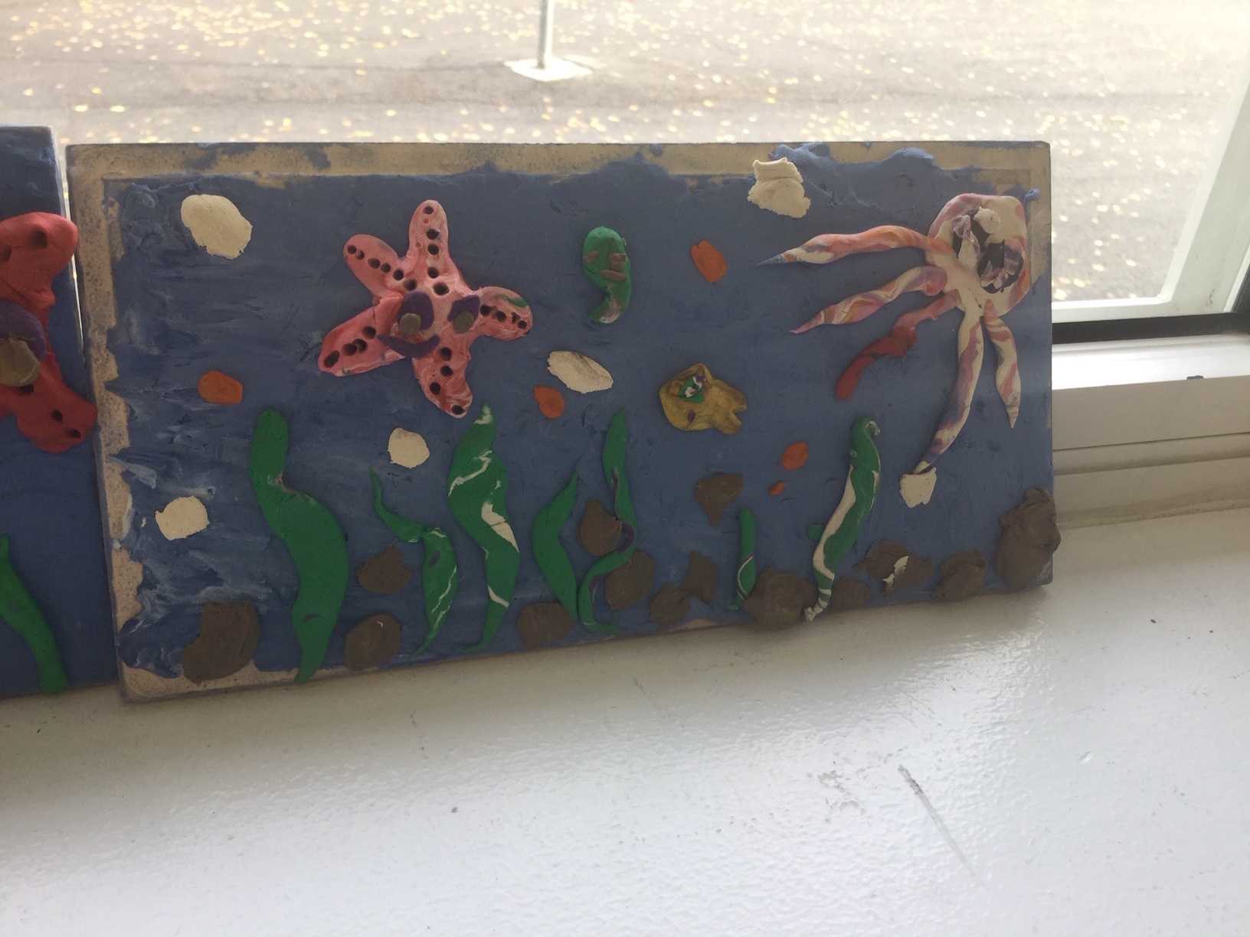
The Symphony Movement 1: The Sea

Slide 13
The Activity Oceanscape with Plasticene
Playlist
https://www.youtube.com/watch?v=IyFpZ5MZ7kk&list=PLykPdvTcbzS6XNgosVy90wsuFykUvSzys

Slide 14
Topics for Inquiry
-connect with inquiry into oceans
-studying sea animals
-environmental considerations with
global warming

Slide 15
Movement 2: The Sky

Slide 16
The Activity
Impressionist- Van Gogh Starry Starry night-
Harmony
Pastel and tempera paint
Playlist
https://m.youtube.com/playlist? list=PL2AC7vvvyyCHZvtCoE-24pjki1fGWjTQP

Slide 17
Starry Starry Night Don Maclean
https://www.youtube.com/watch?
v=DD1ih3Q9otE

Slide 18
Topics for Inquiry
-Inquiry into stars and the universe
-Animals that are nocturnal
-Explore other Impressionist artists
eg. Monet, Matisse, Renoir

Slide 19
Movement 3: The Lands

Slide 20
The Activity-Rhythm Splatter
Tempera paint, popsicle sticks
Warm up –rhythm stick floor jam
https://m.youtube.com/watch?
v=bM700bWu6vc https://
m.youtube.com/watch?
v=5s1RH0JYmAQ

Slide 21
Countries
Japan
https://m.youtube.com/playlist?list=PLXP--
KfaEF5AIqT61B2gUg21OZF56ikgI
Spain
https://m.youtube.com/watch?v=Wye-bzRrD6Y
Cuba
https://m.youtube.com/watch?
v=YEtEisFAKPQ&list=OLAK5uy_nC25rvSd5ZOoOE9Wdf5jM-TTYn0hRTO44&index=1&client=mv-google

Slide 22
Countries
Americas
https://m.youtube.com/watch?v=Zu15Ou-jKM0&list=RDEMCunC5q_RmMbuTYkw3G-k4Q&start_radio=1
Brazil
https://m.youtube.com/watch?v=BDjTdbIZxMQ&t=43s

Slide 23
Topics for inquiry
-Explore the country, the flag,
the culture
-Music, beat and rhythm
-Instruments of the country,
-Sports
-Environmental issues-ex. The
rainforest

Slide 24
Concluding Remarks
We invite you to explore, experiment,
and have fun blending music and art
in your primary classroom.
Students are totally engaged in these
activities as they actively listen to the
music and express themselves through
their art.

Slide 25
Topics for further research
-Discovering Instruments of the
orchestra
-Appreciating different genres of
music
-Using different mediums for art
-Incorporating dance and drama into
the projects

Slide 26
Thank you
We hope you enjoyed today’s session
and can take something back to
use in your classroom!

